Slide 1
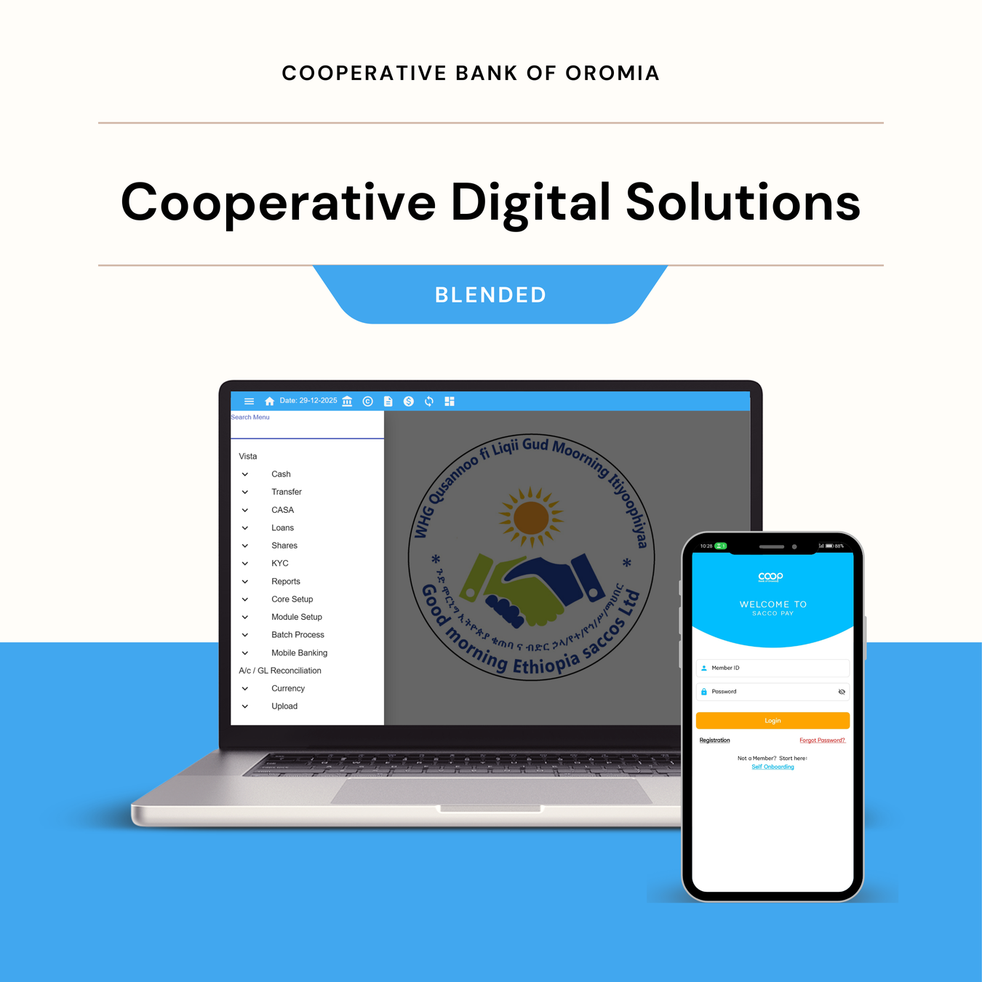


The Big Picture
SACCO-Link
Core Banking + Mobile Banking
Is an integrated Core and Mobile Banking platform designed for SACCOs and Unions to transform them by unlocking their full potential through digital innovation, connecting rural communities to modern banking, and driving sustainable community growth.
Through the SACCOLink platform, we set out to achieve four critical things:
  Digitize operations – replacing manual processes with automated, standardized and secure digital systems.
  Enhance connectivity – linking SACCOs, their members, and the bank in real time.
  Drive growth and competitiveness – enabling cooperatives to efficiently manage a growing membership while delivering standardized, scalable, and flexible financial products and services that adapt to evolving member needs and future growth.
  Power better decisions – providing leaders real-time insights to make informed decisions, to manage risk, grow portfolios, and serve members better.

Slide 2




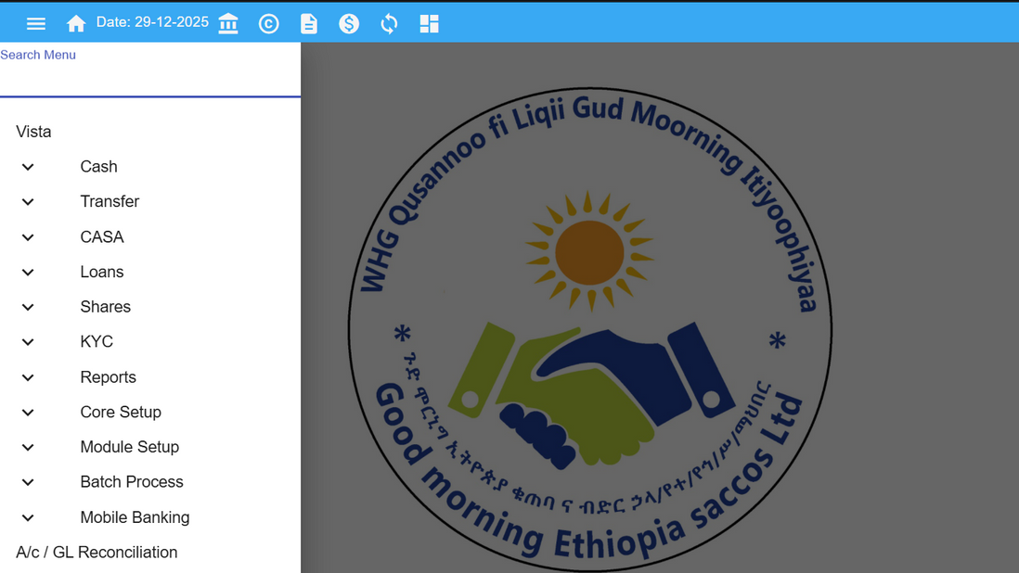


KEY Modules
SACCO-Link Features
Digital KYC
Loan Management
Clean, and complete members profile management
Account based Principal, interest and penalty calculation automations
Savings & Share
Seamless Financial Reports
Secure and transparent Savings, Share and Asset Management Module
Real-time Balance Sheets, Income Statements and TB Reports

Slide 3
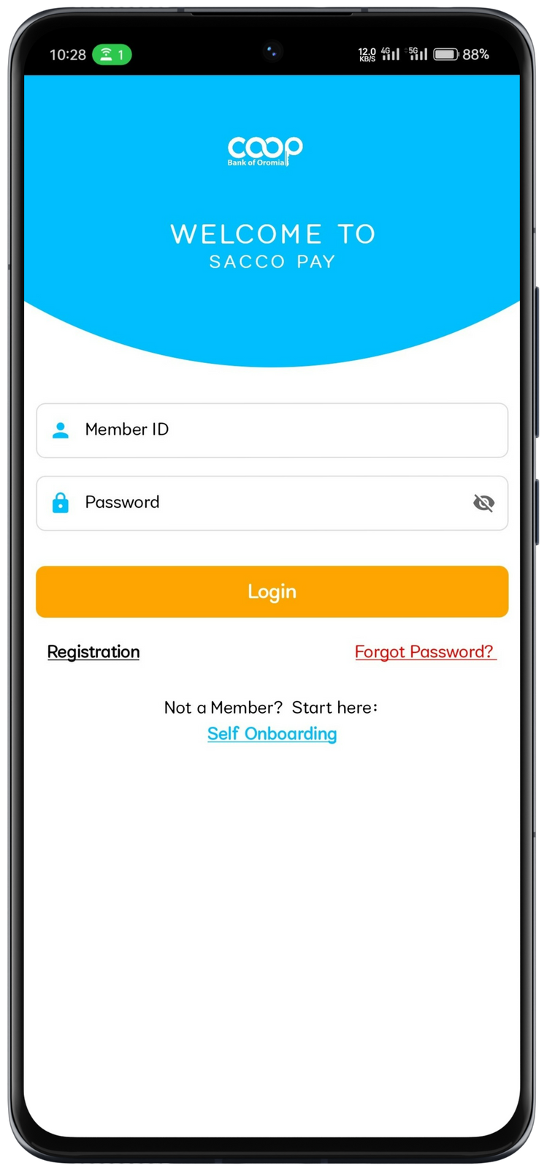
Brief Context
SACCOPay as a driver of SACCOs Expansion
SACCO-Pay
SACCO-Link serves as a core banking solution digitizing SACCOs operations, while SACCOPay is a mobile banking app built on top of SACCOLink, to connect members to their SACCOs and enable SACCOs to deliver their financial services with ease.
As SACCOs expand and reach more members,
It helps members to access SACCO services anytime, anywhere, without visiting the SACCO or bank.
Seamlessly connects members with their SACCOs through a single digital platform.
Keeps member accounts, transactions, and balances synchronized in real time.
SACCOs Mobile Banking Solution

Slide 4
SACCOPAY MOBILE BANKING
Membership Application
Features
New Members can register themselves to SACCOs of their choice directly from the application.
Instant and Direct Payments
Loan Application
Savings Payments(Compulsory/Voluntary)
Loan Payments
Pay using Bank or SACCOs Accounts
Enables existing members to apply for loans anywhere and anytime.
Features
Accounts Management
Helps Manage Savings, Loan and Share
View Account Balances
View & Download Accounts Statements
SMS Alerts and Receipts
SACCOs tailored SMS and Receipts of transactions
Empowering Cooperatives with Technology

Slide 5






How do We Achieve It?
5
A three-phase, step-by-step incremental approach,
1|>. Automation
  Transform manual records and operations into fully digital, system-based processes - improving efficiency, accuracy, and security.
2|>. Integration
Enable seamless core-to-core connectivity between cooperatives and the bank, ensuring real-time transaction flow, visibility, and collaboration.
3|>. Innovate Co-Branded Products & Services
  Build on this digital foundation to deliver impactful financial solutions — including mobile banking for members, co-branded cards, and digital credit products — driving inclusion, growth, and broader community empowerment.

Slide 6


Cooperatives Digital Solution
Product Impact
The following are a high-level figures showing the SACCO-Link impact so far,
Onboarded
Bank Integrated
Mobile Banking Integrated
65
35
15
SACCOs + Unions
SACCOs + Unions
SACCOs
250K+
2K+
Individual Members
Primary Cooperatives

Slide 7
https://coopbankoromia.com.et/coopbank-sacco-link
+251-965-2964-02
Empowering Communities, Transforming Lives
Cooperative Bank of Oromia

